Slide 1
Characterization and Quantification of Fibrinogen and TLT-1 Binding Properties
Charles “Boomer” Russell
Senior Thesis
November 30, 2018

Slide 2
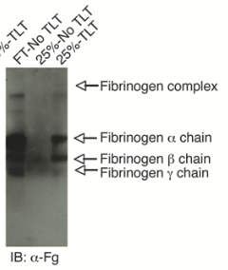
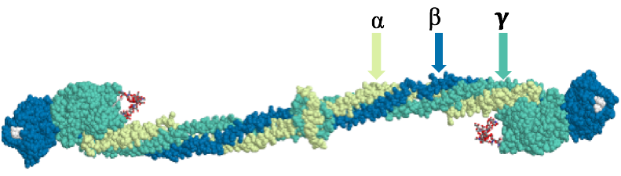
Fibrinogen
Glycoprotein – 340 kDa
3 chains
Thrombin activated to Fibrin
Blood Clot formation
Binds TLT-1
Western Blot showing that Fibrinogen binds to TLT-1

Slide 3
Fn
Fg
Prothrombin
Ca²⁺
Thrombin
V

Slide 4

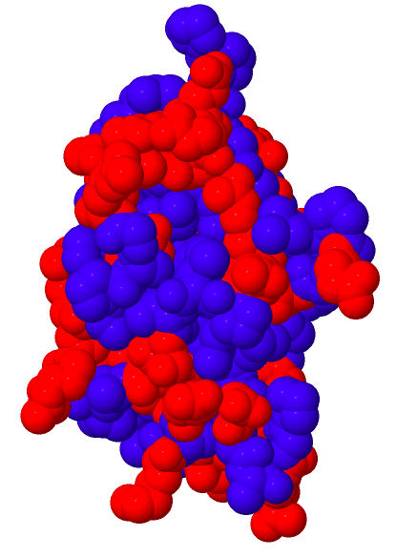
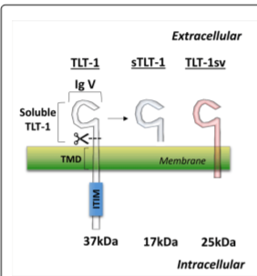
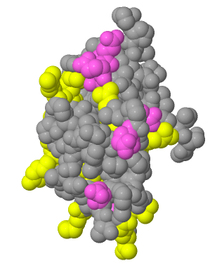
TLT-1 Structure
TREM Like Transcript 1
~18 kDa (127 Amino Acids)
Transmembrane & Soluble
Polar &
non-polar
Beta-Sandwich Motif
Positive & Negative
Charged Residues

Slide 5
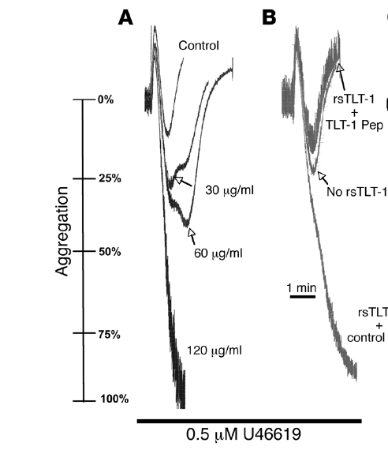
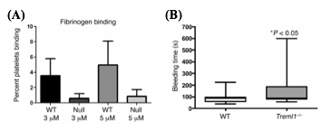
TLT-1 Function
Low TLT-1
Increasing Aggregation
High TLT-1
TLT-1 knockout mice have increased bleeding times
Mediates thrombin activated platelet aggregation

Slide 6
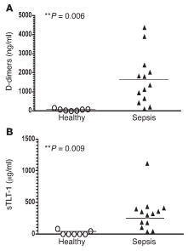
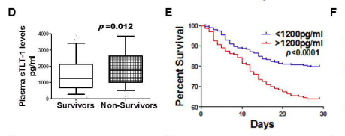
TLT-1 & Sepsis
Septic patients have increased [TLT-1]
High concentrations of TLT-1 indicate less chance of survival

Slide 7
Why We Care
TLT-1 mediates thrombin-activated platelet aggregation
TLT-1 binds to Fibrinogen
TLT-1 is a survival indicator in patients with sepsis

Slide 8
Objectives
Optimize Methodology for TLT-1 Isolation and Purification
Quantify Binding Through Fluorescence
Characterize Binding in Solution through Co-Immunoprecipitation

Slide 9
Isolation & Purification
Isolation
Purification
Refolding
Escherichia Coli
IPTG Induction
Lysis
= Nickel Resin
Immobilized-Metal
Affinity Chromatography
Washing and Elution
Western Blot
= TLT-1
= Non-Specific Proteins
Dialysis
Bradford Assay

Slide 10
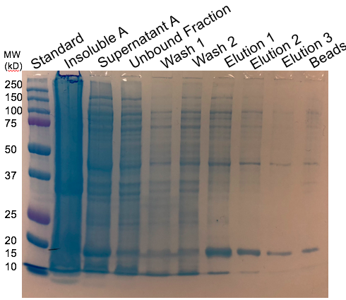
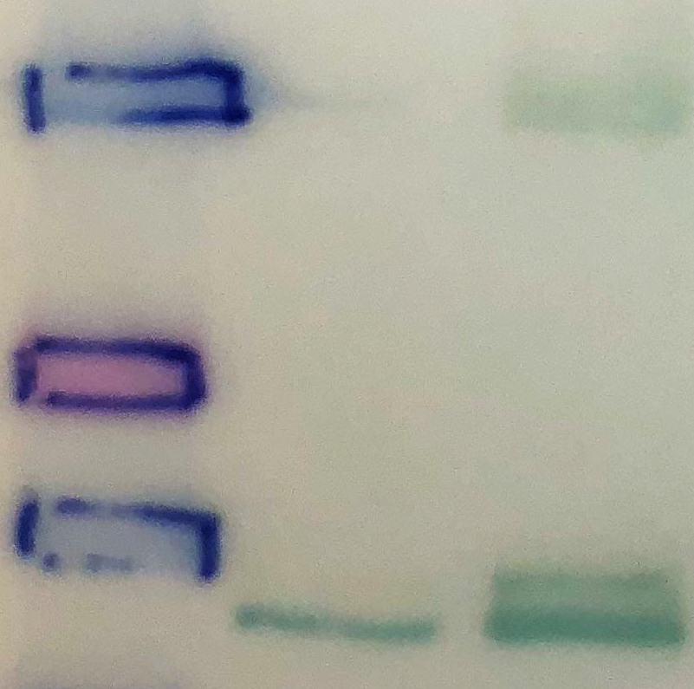
Isolation & Purification Results
Western Blot probed with ab69 (antibody that detects sTLT-1)
SDS-PAGE
Washington TLT-1
Russell TLT-1
Western Blot

Slide 11
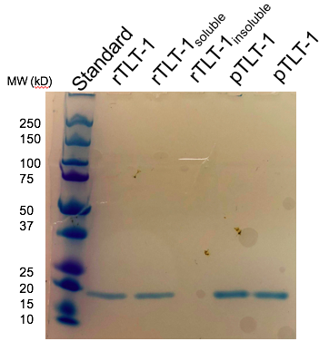
Refolding & Bradford Results
Sample | Dilution Factor | Calculated Concentration (µg/mL) | Calculated Stock Concentration (µg/mL)
A | 1:10 | 17.26 | 172.6
C | 1:50 | 3.4 | 170
E | 1:10 | 15.8 | 158.1
F | 1:50 | 2.15 | 107.5
Refolded TLT-1 = rTLT-1, Pure TLT-1 = pTLT-1

Slide 12
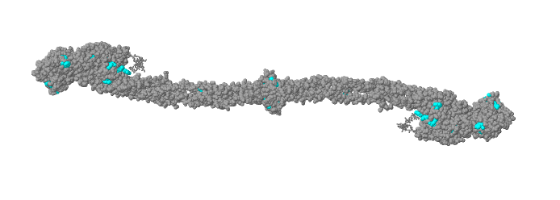
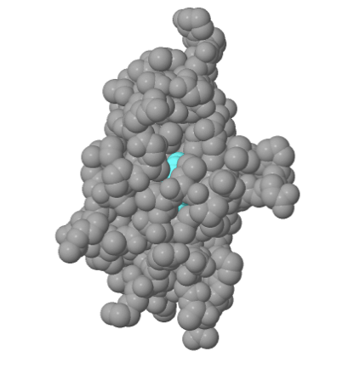
Fluorescence Assays
Intrinsic Tryptophan Fluorescence
Fibrinogen has 72 W | TLT-1 has 1 W
TLT-1 induces conformational changes in Fibrinogen
  Inhibits W fluorescence
Excite @ 280 and 290 nm
Collect between 320-400

Slide 13
Fluorescence Assays Part 1
Increasing [TLT-1]
Perkin Elmer LS – 5B Luminescence Spectrometer

Slide 14
Fluorescence Assays Part 2
Increasing [TLT-1]
M2 SpectraMax Spectrophotometer

Slide 15
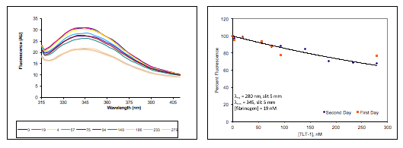
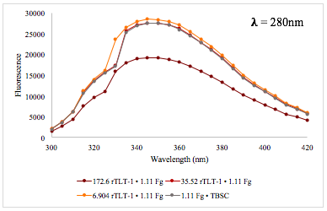
Fluorescence Assay Results
Perkin Elmer LS – 5B Luminescence Spectrometer
M2 SpectraMax Spectrophotometer

Slide 16
Method
Pros Cons
Perkin Elmer LS – 5B Luminescence Spectrometer
Provided consistent results that show binding
Time & Volume
Unreliable concentrations
Low volume
Quick setup
Ability to control concentrations
M2 SpectraMax Spectrophotometer
Inconsistent
Requires optimization

Slide 17
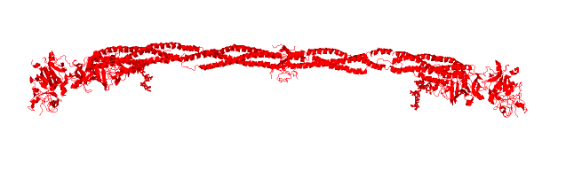
Co-Immunoprecipitation
Nickel
Nickel
Protein A Beads
Protein A Beads

Slide 18
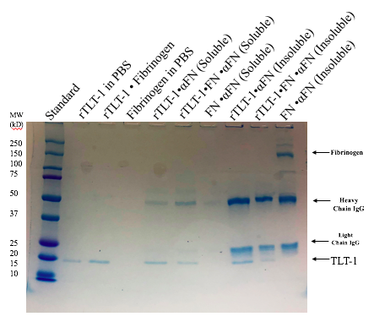
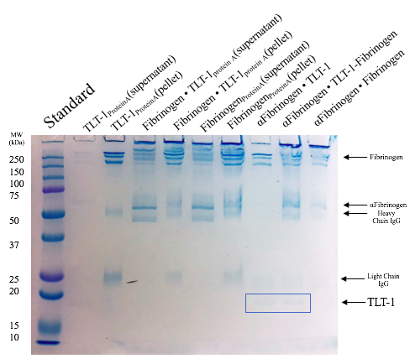
Co-Immunoprecipitation Results
Protein A Beads
TLT-1 present
Fibrinogen Present
Protein A Beads
TLT-1 present
Fibrinogen Present

Slide 19
What’s Next?
Make more TLT-1
Further optimize fluorescence method
  Generate saturation curve
Optimize co-immunoprecipitation
Future Studies
  Heparin
  Where does TLT-1 bind

Slide 20
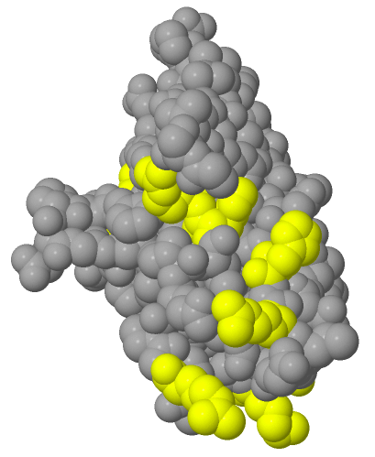
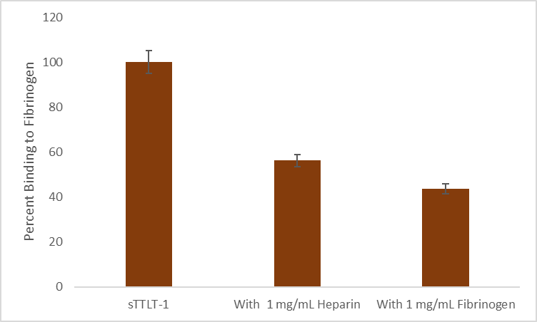
Future Studies: Heparin
Heparin is a (-) charged glycosaminoglycan
Strip of (+) amino acids on TLT-1
Heparin competitively inhibits TLT-1 binding to Fibrinogen
Only
TLT-1
TLT-1 &
Heparin
TLT-1 &
Fibrinogen

Slide 21
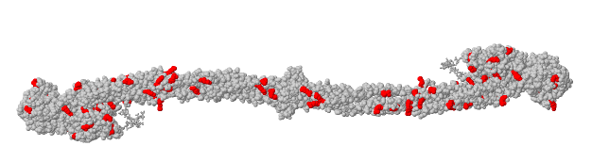
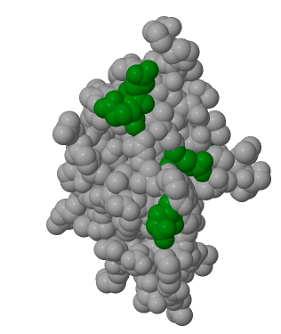
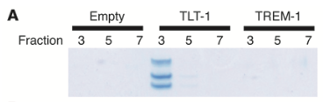
Future Studies: The Binding Pocket
Arginine residues on Fibrinogen forms a pocket structure
Glutamate residues on TLT-1
  Electrostatic interactions
How do we test this?
  Buffers
  Mutation

Slide 22
Acknowledgements
Maryville College Division of Natural Sciences
Scots Science Scholars 2017 & 2018
Dr. Angelia Gibson
Dr. Jerilyn Swann
Dr. Valence Washington
  University of Puerto Rico – Rio Piedras
Manal Abbas
My family and friends
Questions?

